Slide 1
INTRODUCTION
Sports and Games
Lecturer: Ms Maryam Zahra
Department of Health & Physical Education
LCWU Lahore.
Email:maryamsyed565@gmail.com

Slide 2
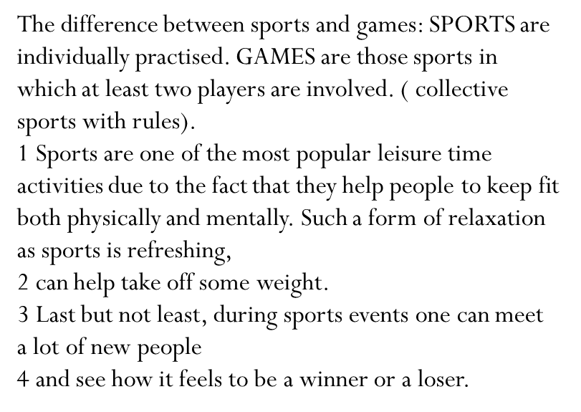
Sports and Games

Slide 3
Definition
Sports is an outdoor or indoor game, competition, or activity needing physical effort and skill and usually carried on according to rules.

Slide 4
Some people say that sport is a physical activity governed by rules and played by individuals seeking to outperform opponents, while others can understand sport as organized spontaneous exercises or games, or as a competitive or non-competitive process through which an individual obtains physical skills, mental relaxation and bodily fitness

Slide 5
Sport gives people enjoyment, happiness, friendship, satisfaction, health, fitness, popularity, recognition, the feeling of victory and success, but on the other hand, it may be boring, cause sadness, sorrow, disappointment, fatigue, exhaustion, injuries, illness, and in some cases even death

Slide 6
CATEGORIZATION OF SPORT
the purpose, aim or objective of the sport: 1) recreational sport/ sport for all, competitive sport, elite sport/ top performance sport, 2) amateur sport, professional sport
the sport facility or environment used: e.g. indoor sports, outdoor sports, water sports, underwater sports, aquatics, air sports, sports on the ice, track and field events in athletics, street sports, school sport
the equipment or gear used: e.g. racquet sports/ games, technical sports, motor sports, cycling sports, skiing sports, para sports, ball games, goal games, equestrian (horse riding), shooting sports
the abilities and health of participants: sport for the disabled
the number of participants: individual sport, team sport
the sex (gender) of participants: men’s/ male sport, women’s/ female sport
the age of participants: sport of children, junior sport, senior sport

Slide 7
CATEGORIZATION OF SPORT
the usual, typical or prevailing season of practicing the sport: summer sports, winter sports, all-season sports
the regional criteria: local sport, regional sport, national sport, traditional sport, Olympic sport, worldwide/ global sports
the way of performance: contact sports, combat sports, Martial arts

Slide 8
Sports and Movement
Sports and movement are given more and more attention these days. This is the result of a busy and comfortable life full of modern inventions (cars, lifts, telephones, sitting in front of TV or PCs) In fact, sports have positive effect on both the body and the soul as well as our self-confidence. They help us stay healthy, relax, develop and train muscles, keep fit, increase our immunity, in other words, we feel better and not only that. Sports improve features such as stamina (usilie) and will (vola).

Slide 9
A Usually all sports and games are further differentiated into:
A Usually all sports and games are further differentiated into:
A / Indoor sports:
Include for example gymnastics, table tennis, boxing, wrestling, weight-lifting, aerobics or gymnastics. They are practiced in gymnasiums or in sport centers.
B / Outdoor sports:
Include for example skiing (down-hill, cross-country, slalom, ski jump), sledging, hiking rock climbing, horse riding, golf, some aquatic sports such as rowing or windsurfing. Athletics: high jump, pole- jump, long jump, triple jump, track and fields events, long- distance runs, marathon, hurdle- race, cross- country run, walking race, relay race, pentathlon, decathlon, javelin/ discus/ hammer throw. The games are usually all- season activities practiced both indoors and outdoors.
e. g. athletic meetings in all the track and field events (sprints, middle and long distance runs, hurdling, high and long jump, pole vault, shot put, javelin and discus throw) take place in summer stadiums as well as in athletic halls.

Slide 10
activities practiced both indoors and outdoors.
e. g. athletic meetings in all the track and field events (sprints, middle and long distance runs, hurdling, high and long jump, pole vault, shot put, javelin and discus throw) take place in summer stadiums as well as in athletic halls.
activities practiced both indoors and outdoors.
e. g. athletic meetings in all the track and field events (sprints, middle and long distance runs, hurdling, high and long jump, pole vault, shot put, javelin and discus throw) take place in summer stadiums as well as in athletic halls.

Slide 11
Sports and games can be divided into
summer – golf
winter - skiing

Slide 12
Values of Sports and Games
Need and importance of physical education and sports in modern era are as follows:
A physical educator considers the child as a storehouse of various mental, social and physical qualities. He tries to develop all the innate qualities with the help of various physical activities, which are parts of physical education.
Various kinds of physical activities help in developing the organic system and functioning of the body. They also improve the abilities of human being to resist fatigue, to remain active and perform efficiently

Slide 13
Physical activities help in developing various kinds of intellectual qualities inherent in a child. Thus with the help of physical education, it is possible to develop children intellectually
By participating in various kinds of physical activities, children becomes emotionally mature
Generally, more than one player participate in physical activity and when people’ of different background and society come into personal contact with each-other, they learn to work in groups, with utmost co-operation and co-ordination

Slide 14
By participating in physical activities, qualities of group efforts, loyalty to the team and strong ties can be developed in participants. These qualities help in building a good moral character of the individuals.
To participate in any event, all the players are required to learn the fundamental skills and rules of the games as well. If they do not work according to the rules, they can be disqualified even from the game.
. Human body is a composition of muscular and nervous systems, and to keep the body in proper condition, it is necessary to keep these systems fit and in good working conditions.

Slide 15
These systems will function properly if there be a kind of co-ordination between them. Such kind of co-ordination can be developed with the help of various physical activities. Thus, physical education helps in developing the neuro-muscular systems of the human body.
In all the team sports or in those activities in which more than one player participate, one player is appointed as the captain who functions as a leader.

Slide 16
Today, activities of physical education are being organized on national as well as on international levels. When players of more than one country take part in the games, they come in personal contact with each other.
On the basis of above discussion it can be said that physical education plays a very important role in the modern world and everyone must participate in any kind of physical activity.

Slide 17
RECREATIONAL, COMPETITIVE AND ELITE SPORT
Recreational sport is also called sport for all and is done for various purposes, but mainly for fun and entertainment in leisure time. An increasing number of people are becoming health-conscious and do recreational sport activities and various keep-fit exercises to maintain or improve their physical as well as mental fitness and health, to affect their flexibility, to strengthen their muscles and shape the body, to delay ageing symptoms, etc. Some people desire to learn new skills or experience new feelings through sport activities. Some people might have social reasons for their participation in sport including the need of integration, friendship, team work, support, recognition etc.

Slide 18
Competitive sport is done mainly for performance, for achieving good results in competitions, defeating opponents and becoming the winner or record holder. People who do competitive sport train hard and regularly and participate in various forms of competition. They are organized and belong to different sport teams, clubs, associations or federations. The highest level of competitive sport is elite sport (top performance sport). Elite athletes must sacrifice almost everything to their sport. It lasts many years to become an excellent sportsman. Such a process means years of hard everyday training, effort and drudgery, years of pain and stress as well. Financial and social background is a necessity. Elite athletes are often professionals who make living through sport. They follow principles of sport training to make progress, including various regeneration programmes. The elite sport is linked with a serious problem – doping, the use of illegal substances to improve performance.

Slide 19
AMATEUR AND PROFESSIONAL SPORT
Amateur sportsmen take part in sport because of the enjoyment and satisfaction gained from the activity. They train and compete in their leisure time, usually after work or at weekends. They are not paid for that.
Professional sport is a paid form of participation in sport events. Professional athletes make living through sport, do sport as a job, are paid to compete in sport. Winning and success are the most important things. The more successful professionals are the more money they earn. They usually train full-time and devote themselves to their sport. They sign contracts with different organisations or firms, have to train properly, participate in competitions, promote the employer or his/her products, take part in press conferences, advertising campaigns, etc.
The international governing bodies of each sport draw up rules to decide who is amateur in their sport. They decide if professionals may compete with amateurs.

